Slide 1




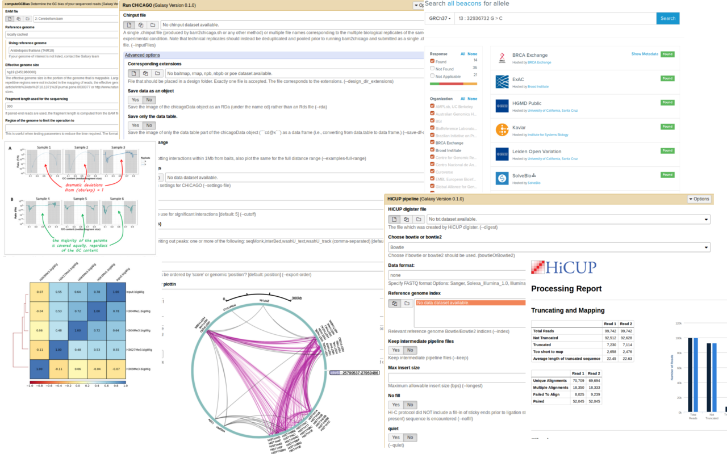
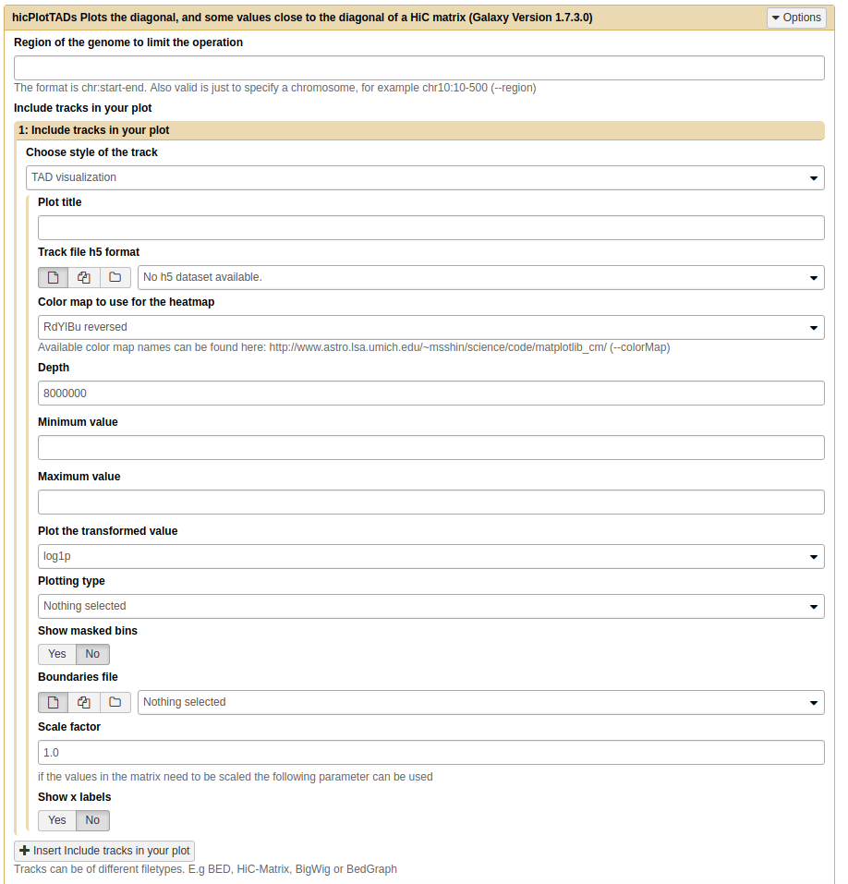



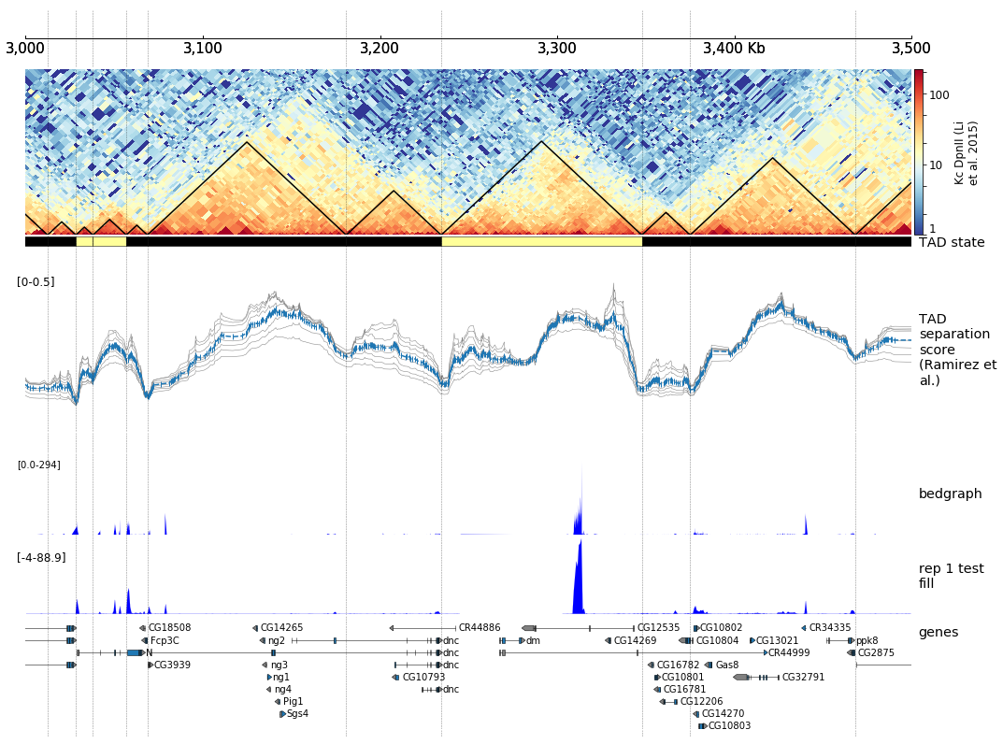
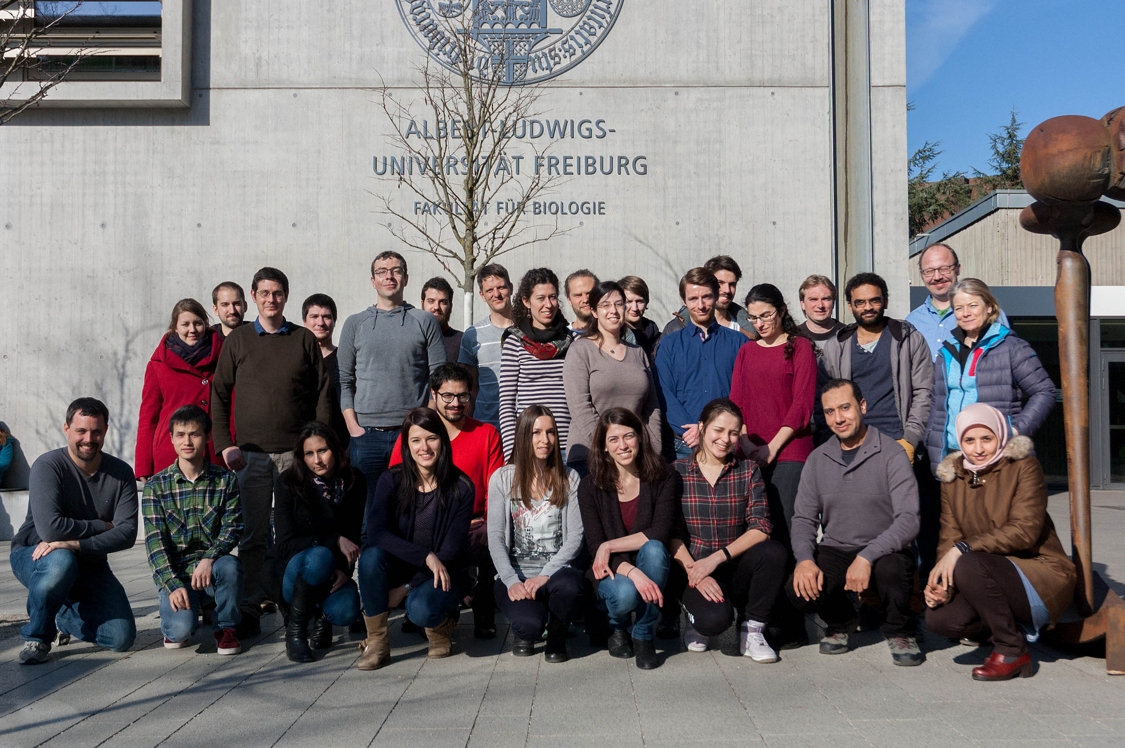
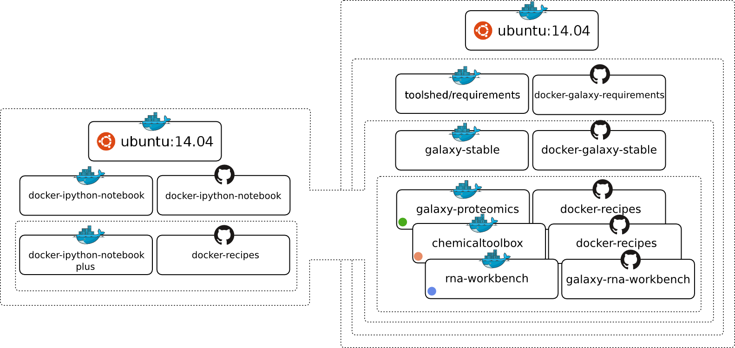

de.NBI-epi
RNA Bioinformatics Center
University of Freiburg
Chair of Bioinformatics
Fkz 031L0101C
Björn Grüning, Joachim Wolff
University of Freiburg, Germany
Description of de.NBI-epi
de.NBI services
The de.NBI-epi project in Freiburg offers:
Visualization, normalization and quality assessment:
Hi-C data analysis
MethylC-Seq data analysis
ChIP-Seq
Bisulfite sequencing analysis pipelines
Training and user support:
Galaxy HTS data analysis workshops
Self learning material on https://training.galaxyproject.org
Direct user support via gitter, GitHub or guest researcher
Available on:
All in one Gateway: https://usegalaxy.eu
Your computer with virtualized and personalized instances
Maintenance, development and integration of software into Galaxy to provide easy access for epigenetic analysis software:
deepTools
Bismark
HiCUP
CHiCAGO
Methyldackel
Methtools
HiCExplorer
Galaxy
Container: Docker, rkt, Singularity
Progress report
General information on the project
Development and maintenance of software for Hi-C data analysis.
HiCExplorer:
Maintenance of HiCExplorer
Extending available tools with new functions
Loop detection
Support of more file formats
Support of cHi-C data analysis
Validation of loops
Improved training material: https://hicexplorer.readthedocs.io
scHiCExplorer:
New software to support single-cell Hi-C data analysis:
Tools to demultiplex raw fastq files
Create mCool matrices and manipulation
Methods to reduce dimensions of scHi-C data
Methods to cluster scHi-C data
As part of the de.NBI-epi project in Freiburg, Joachim Wolff and Björn Grüning, are working closely with the RBC, de.NBI, ELIXIR andEOSC-life to deliver high-class services for epigenetic research.
General information on the project
Community based infrastructure
Bioconda is a conda channel which provides software for biomedical research.
25,649 commits on GitHub
856 contributors
> 7,300 packages
BioContainers provides system-agnostic executable environments for bioinformatics software.
Based on Docker & rkt
> 33,000 containers
Automatic builds from Bioconda
Galaxy is an open, web-based platform for data intensive research.
43,998 commits
223 contributors
One of the biggest Galaxy instances available for de.NBI in Freiburg
de.NBI Training and education
Hands-on training material for self-study available on training.galaxyproject.org
Introduction to HTS
RNA-Seq
ChIP-Seq
Proteomics
MethylC-Seq
...and many more!
The Galaxy Docker Project
The Galaxy Docker Image is an easy distributable full-fledged Galaxy installation, that can be used for testing, teaching and presenting new tools and features.
Portable data analysis in a box!
2018 / 2019 past events
06th – 07th Dec 2018 | Galaxy RNA-Seq analysis workshop | Freiburg
17th – 18th Jan 2019 | Galaxy RNA-Seq analysis workshop | Belgrad, SP
25th Feb – 01st Mar 2019 | Galaxy Workshop | Freiburg
23rd – 26th Apr 2019 | Elixir Galaxy Community Workshop | Roscoff, FR
1st – 6th Jul 2019 | Host of Galaxy Community Conference (GCC) | Freiburg
24th Jul 2019 | ISMB: Workshop for reproducible research | Basel, CH
16th Sept 2019 | GCB: Workshop for Workflows, Tools and Data Management | Heidelberg
23rd – 27th Sept 2019 | Galaxy Workshop | Freiburg
Based on the main Galaxy Docker virtualization, a dedicated flavor for epi-
genetics was developed: github.com/bgruening/docker-galaxy-epigenetic
Publications
High-resolution TADs reveal DNA sequences underlying genome organization in flies.
doi: 10.1101/115063
Jupyter and Galaxy: Easing entry barriers into complex data analyses for biomedical researchers.
doi: 10.1371/journal.pcbi.1005425
The RNA workbench: best practices for RNA and high-throughput sequencing bioinformatics in Galaxy
doi: 10.1093/nar/gkx409
BioContainers: an open-source and community-driven framework for software standardization
doi: 10.1093/bioinformatics/btx192
www.denbi.de

